Slide 1
Documenting and Reproducing Data Wrangling Workflows
Code Comments, Markdown Files, and Jupyter Notebooks, Version Control and Collaboration Using Git and GitHub

Slide 2
Documenting Data Wrangling Processes
Outline data sources and data collection methods
Describe data cleaning steps for consistency
Document transformations and data reshaping techniques
Note any missing data handling approaches
Record feature engineering and variable selection
Summarize tools and libraries used in the process

Slide 3
Code Comments
Code comments are annotations in the code that help explain its logic, purpose, or functionality.
These comments are ignored by the compiler or interpreter, making them exclusively for developers' benefit.
Comments serve several purposes: they improve readability, explain complex logic, and provide context for specific coding decisions.
There are different types of comments, such as single-line comments, which are ideal for brief notes (e.g., # Initialize variable to store user age).
Multi-line comments work better for more detailed explanations, like explaining a function's purpose:

Slide 4
Code Comments
"""
This function calculates the square of a number.
It accepts one parameter 'num' and returns 'num' squared.
"""
def square(num):
return num * num

Slide 5
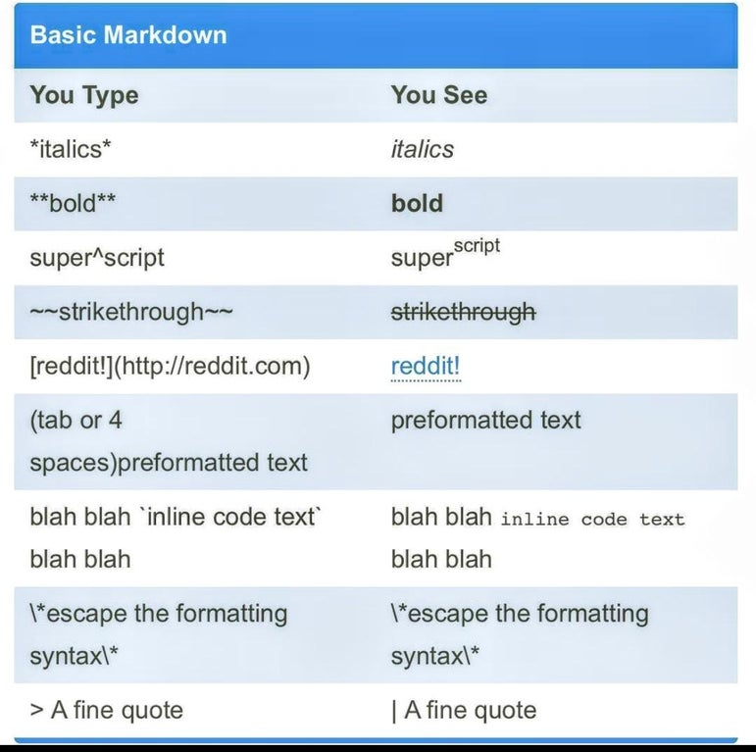
Markdown Files
Markdown is a lightweight markup language used for creating formatted text using a plain text editor.
It has the file extensions `.md` or `.markdown` and is known for its simplicity and readability.
Markdown allows users to format text with headings, lists, links, images, and code blocks without complex syntax, making it popular for writing README files, project documentation, and web content.
Key properties include its portability, as it can be converted to HTML or other formats, and versatility with features like bold and italic text, tables, and inline code.
Tools like VS Code and platforms like GitHub support and extend Markdown's functionality, including GitHub Flavored Markdown (GFM) that adds features like tables and task lists.

Slide 6
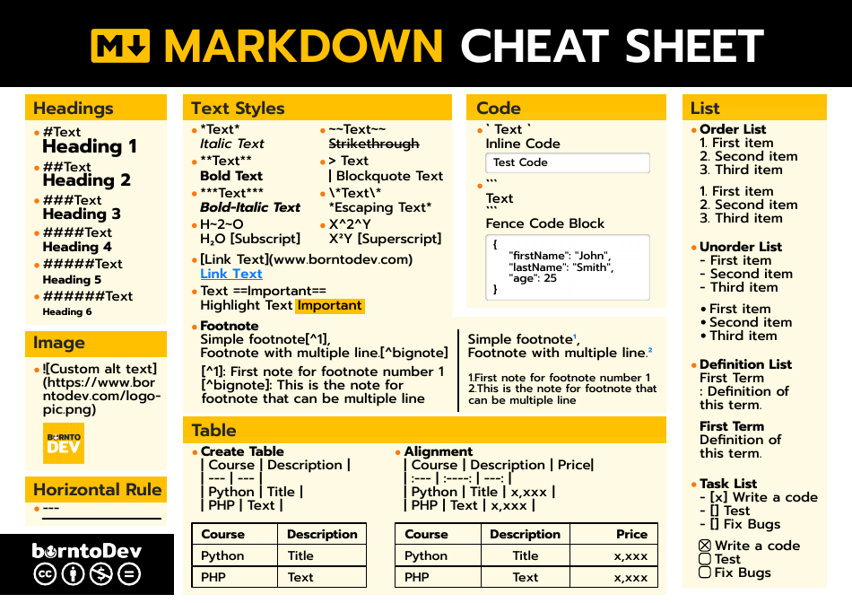

Slide 7
Jupyter Notebook
Jupyter Notebook is an open-source, interactive web application that allows users to create and share documents that contain live code, equations, visualizations, and narrative text. It supports various programming languages, with Python being the most commonly used. Jupyter Notebooks are widely used in data science, machine learning, and research for tasks like data cleaning, visualization, statistical modeling, and code prototyping.
Key features include:
Interactive Coding: Run code cells independently, visualize results instantly, and make adjustments quickly.
Data Visualization: Embed charts and graphs directly within the notebook for a clear presentation of data.
Rich Text Support: Combine code with Markdown cells for formatted text, equations, and explanations to create well-documented, narrative workflows.
Extensibility: Compatible with various libraries and extensions, Jupyter Notebooks can be customized for specific needs, including support for widgets, interactive dashboards, and remote collaboration.

Slide 8
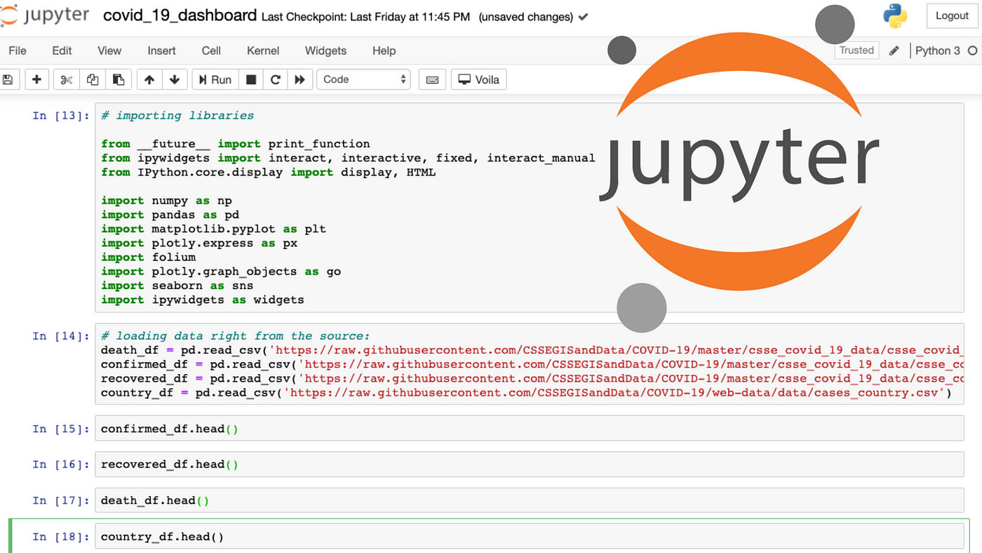

Slide 9
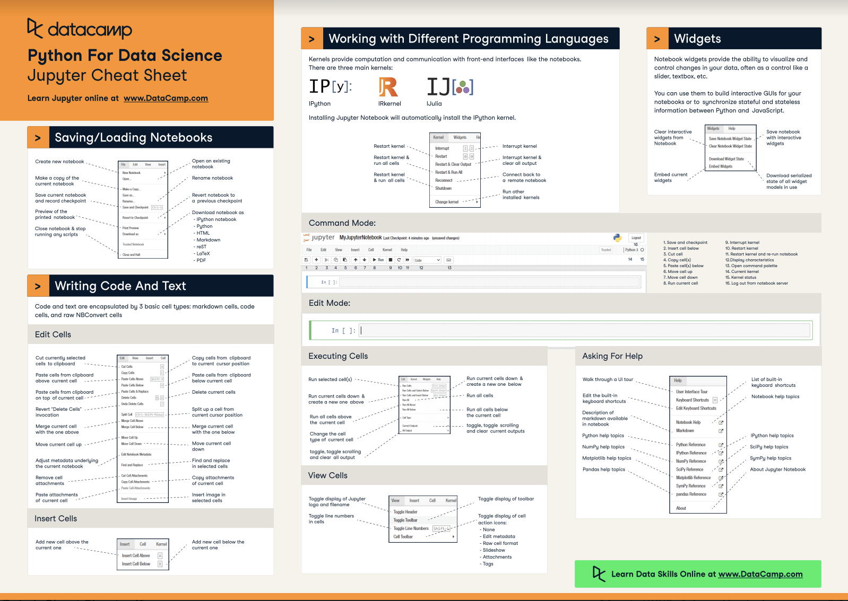

Slide 10
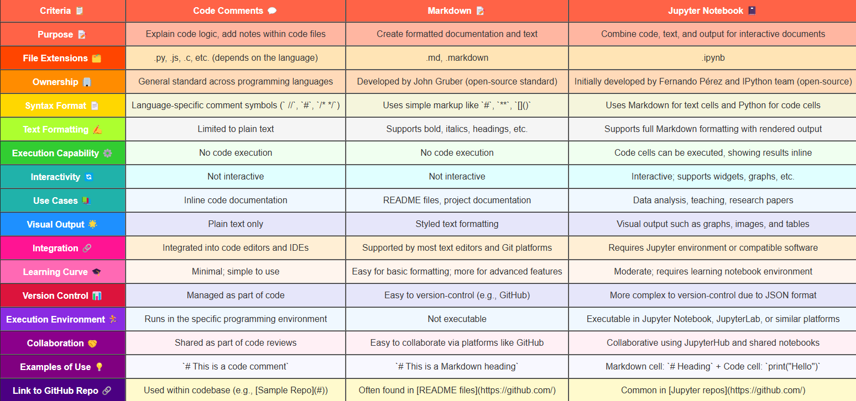

Slide 11
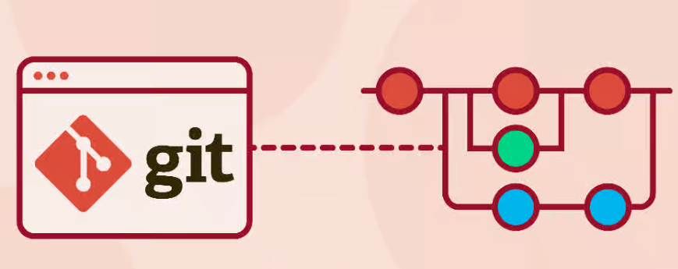
Git
Git is a distributed version control system designed to track changes in source code efficiently, allowing multiple developers to collaborate on a project.
It keeps a history of all modifications, making it easy to revert to previous versions, manage branching and merging, and ensure that changes are controlled in a structured way.
Key commands include git init (to initialize a repository), git add (to stage changes), git commit (to save changes), git branch (to manage branches), and git merge (to combine changes).

Slide 12
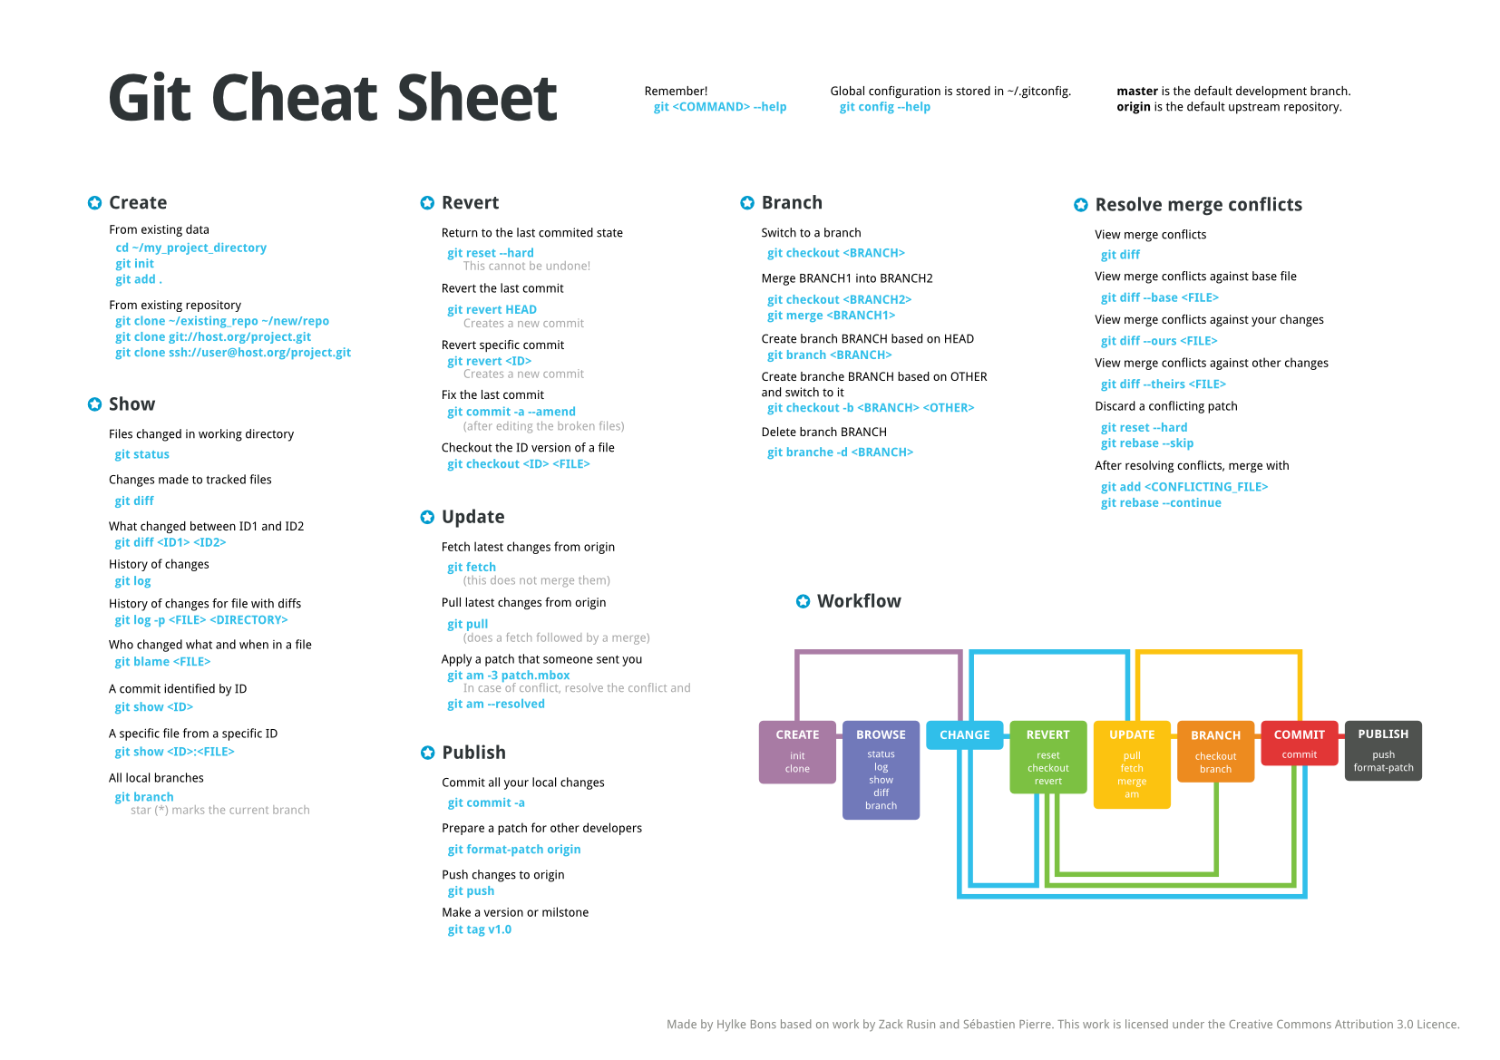

Slide 13
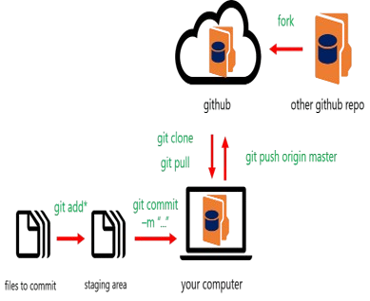
GitHub
GitHub is a cloud-based platform that hosts Git repositories, providing a collaborative environment for developers.
GitHub adds an online interface to Git, enabling developers to manage projects, review code, track issues, and contribute through pull requests.
It also includes features like GitHub Actions for automation, GitHub Pages for project websites, and integration with other tools for CI/CD, project management, and code review.

Slide 14
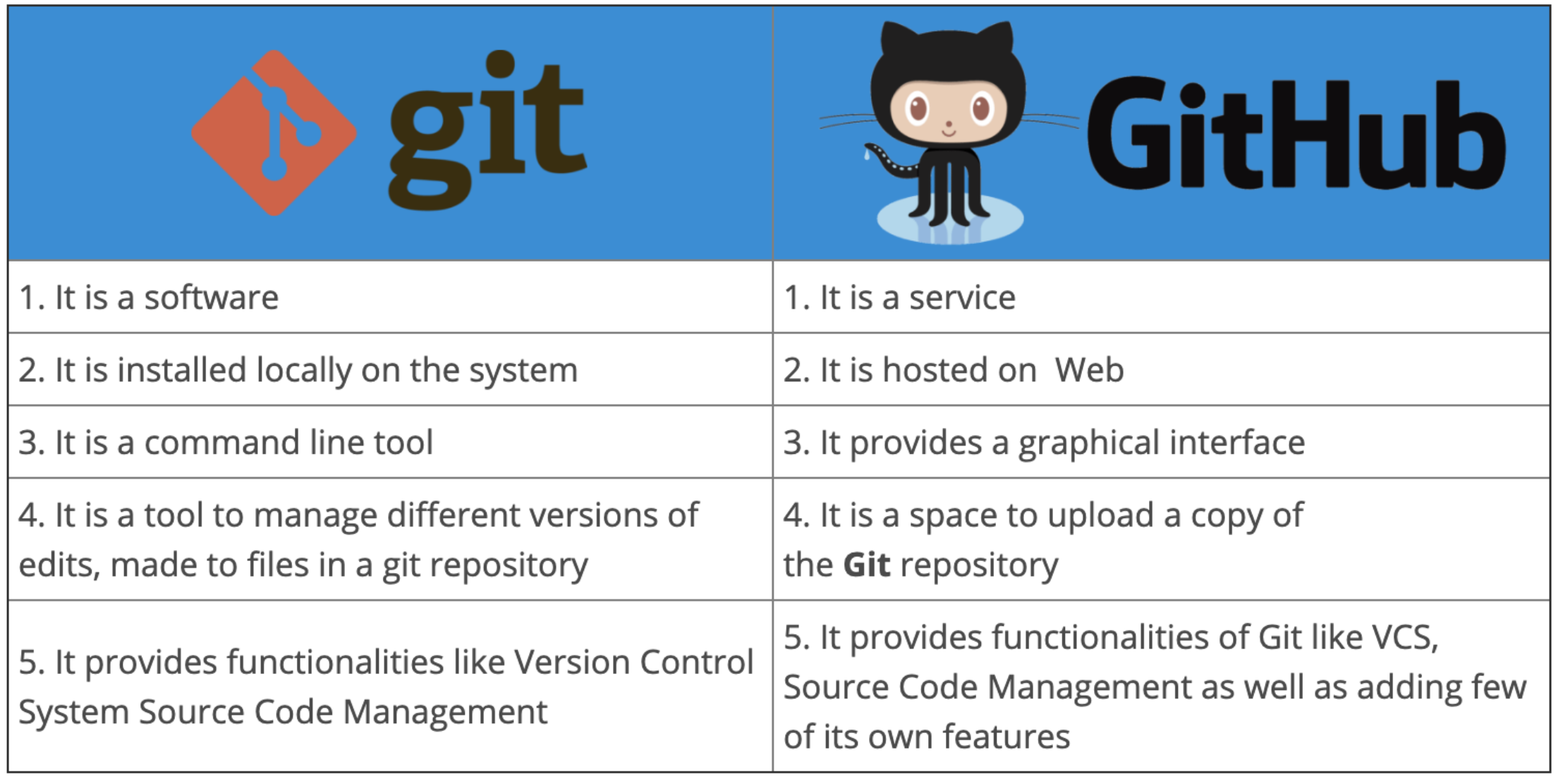

Slide 15
Resources
Webpage for Git Commands: Git Commands
Repository for Learning Git: Learning Git Repository
GitHub Guide: GitHub Documentation
Markdown Style Guide: Markdown Guide
Jupyter Notebook Documentation: Jupyter Documentation

